Slide 1
Chapter 2: Intro to Relational Model

Slide 2

Example of a Relation
attributes
(or columns)
tuples
(or rows)

Slide 3
Attribute Domain and Value Types
The set of allowed values for each attribute is called the domain of the attribute
Attribute values are (normally) required to be atomic; that is, indivisible - Set of values is not atomic.
The special value null is a member of every domain. Indicated that the value is “unknown”
The null value causes complications in the definition of many operations

Slide 4
Relation Schema and Instance
A₁, A₂, …, A_{n} are attributes
R = (A₁, A₂, …, A_{n} ) is a relation schema
Example:
instructor = (ID, name, dept_name, salary)
Formally, given sets D₁, D₂, …. D_{n}, a relation r is a subset of
D₁ x D₂ x … x D_{n}
Thus, a relation is a set of n-tuples (a₁, a₂, …, a_{n}) where each a_{i} ∈ D_{i}
The current values (relation instance) of a relation are specified by a table
An element t of r is a tuple, represented by a row in a table

Slide 5

Relations are Unordered
Order of tuples is irrelevant (tuples may be stored in an arbitrary order)
Example: instructor relation with unordered tuples

Slide 6
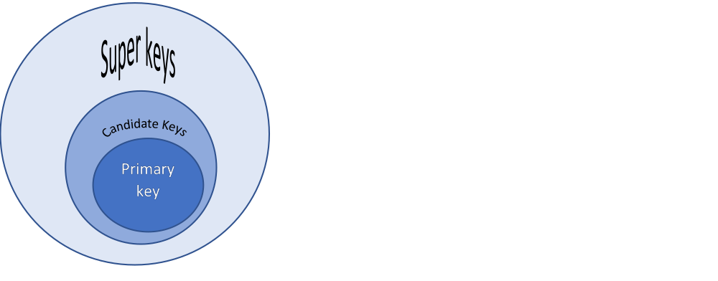
Keys
Let K ⊆ R
K is a superkey of R if values for K are sufficient to
identify a unique tuple of each possible relation r(R)
  Example: {ID} and {ID,name} are both superkeys of instructor.
Superkey K is a candidate key if K is minimal
Example: {ID} is a candidate key for Instructor
One of the candidate keys is selected to be the primary key.
  which one? –chosen by database designer – never changed attr. SSN, roll no, employee id etc
  underlined
Foreign key constraint: Value in one relation must appear in another
  Referencing relation
  Referenced relation
  Example – dept_name in instructor is a foreign key from instructor referencing department

Slide 7

Keys Example
ID, name, dept_name , salary together can be super key
ID alone is candidate key
dept_name in instructor is a foreign key from instructor referencing department

Slide 8
Schema for University Database
department( dept_name, building, budget)
course(course_id, title, dept_name, credits)
.
.
.
.
.
.
Instructor(ID, name, dept_name, salary)
You get this schema after working through a database design process

Slide 9

Schema Diagram for University Database
You will be able to identify the relationships in the design process

Slide 10
Relational Query Languages
Allow users to request information from the database.
Procedural vs .non-procedural, or declarative
“Pure” languages:
  Relational algebra
  Tuple relational calculus
  Domain relational calculus
The above 3 pure languages are equivalent in computing power
Pure languages form underlying basis of query languages that people use.
We will concentrate in this chapter on relational algebra
  consists of 6 basic operations

Slide 11
What is “Algebra”
Mathematical model consisting of:
  Operands --- Variables or values;
  Operators --- Symbols denoting procedures that construct new values from a given values
  Ex: x+y = 5
Relational Algebra is algebra whose operands are relations and operators are designed to do the most commons things that we need to do with relations

Slide 12
Select Operation
Notation: σ _{p}(r)
p is called the selection predicate
Defined as:
σ_{p}(r) = {t | t ∈ r and p(t)}
Where p is a formula in propositional calculus consisting of terms connected by : ∧ (and), ∨ (or), ¬ (not)
Each term is one of:
<attribute> op <attribute> or <constant>
where op is one of: =, ≠, >, ≥. <. ≤
Example of selection:
Find all instructor from History department.
SQL query: select * from instructor where dept_name = “History”
equivalent relational expression: σ _{dept_name=“History”}(Instructor)

Slide 13

Select Operation – selection of rows (tuples)
Relation r
σ_{A=B ^ D > 5} (r)

Slide 14
Project Operation
Notation:
∏_{A1, A2, …, Ak} (r)
where A₁, A₂ are attribute names and r is a relation.
The result is defined as the relation of k columns obtained by erasing the columns that are not listed
Duplicate rows removed from result, since relations are sets

Slide 15

Project Operation – selection of columns (Attributes)
Relation r:
∏_{A,C} (r)

Slide 16
Union Operation
Consider relational schemas:
Depositor(customer_name, account_number)
Borrower(customer_name, loan_number)
For r ∪ s to be valid.
1. r, s must have the same number of attributes
2. The attribute domains must be compatible (e.g., 2nd column of r deals with the same type of values as does the 2nd column of s)
Find all customers with either an account or a loan
∏_{customer-name} (depositor) ∪ ∏_{customer-name} (borrower)

Slide 17
Union Operation
Notation: r ∪ s
Defined as:
r ∪ s = {t | t ∈ r or t ∈ s}

Slide 18

Union of two relations
Relations r, s:
r ∪ s:

Slide 19

Set difference of two relations
Relations r, s:
r – s:
Notation r – s
Defined as: r – s = {t | t ∈ r and t ∉ s}

Slide 20

Set intersection of two relations
Relation r, s:
r ∩ s
Note: r ∩ s = r – (r – s)

Slide 21
Cartesian-Product Operation
Notation r x s
Defined as:
r x s = {t q | t ∈ r and q ∈ s}
Assume that attributes of r(R) and s(S) are disjoint. (That is, R ∩ S = ∅ ).
If attributes of r(R) and s(S) are not disjoint, then renaming must be used.

Slide 22

joining two relations -- Cartesian-product
Relations r, s:
r x s:

Slide 23
Cartesian-product – naming issue
B
Relations r, s:
r.B
s.B
r x s:
Requires when two relations are not disjoint i.e r ∩ s ≠ Ǿ

Slide 24
Renaming a Table
Allows us to refer to a relation, (say E) by more than one name.
ρ _{x} (E)
returns the expression E under the name X
Relations r
r.A r.B s.A s.B
r x ρ _{s} (r)
α
α
β
β
1
1
2
2
α
β
α
β
1
2
1
2

Slide 25

Composition of Operations
Can build expressions using multiple operations
Example: σ_{A=C} (r x s)
r x s
σ_{A=C} (r x s)

Slide 26
Joining two relations – Natural Join
Let r and s be relations on schemas R and S respectively.
Then, the “natural join” of relations R and S is a relation on schema R ∪ S obtained as follows:
  Consider each pair of tuples t_{r} from r and t_{s} from s.
  If t_{r} and t_{s} have the same value on each of the attributes in R ∩ S, add a tuple t to the result, where
    t has the same value as t_{r} on r
    t has the same value as t_{s} on s
  EX:
  R = (A, B, C, D)
  S = (E, B, D)
  Result schema = (A, B, C, D, E)

Slide 27

Natural Join Example
Relations r, s:
Natural Join
  r s
∏ _{A, r.B, C, r.D, E} (σ _{r.B = s.B ˄ r.D = s.D} (r x s)))

Slide 28
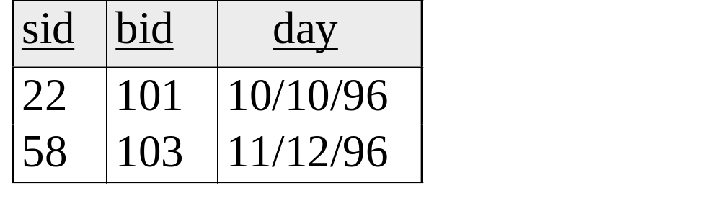
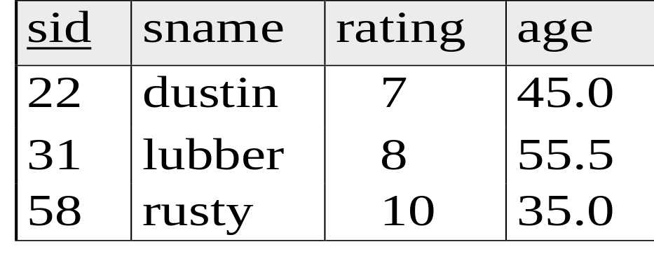
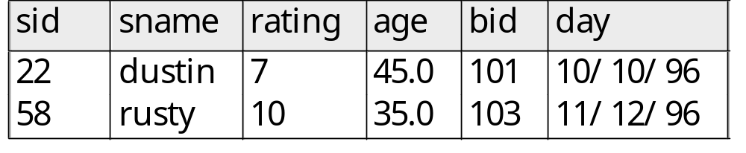
Natural Join Example
R1
S1
R1 S1 =

Slide 29

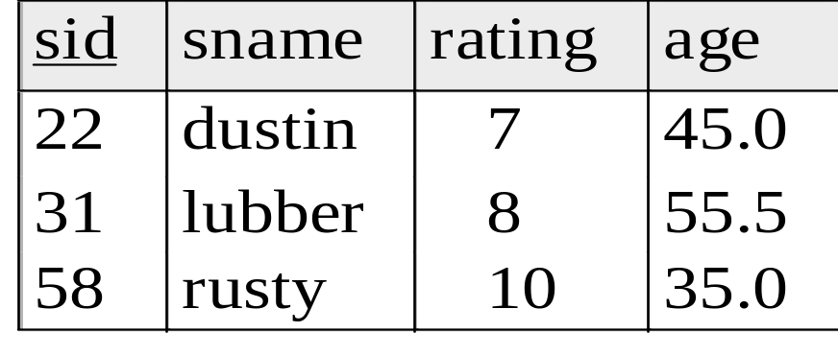
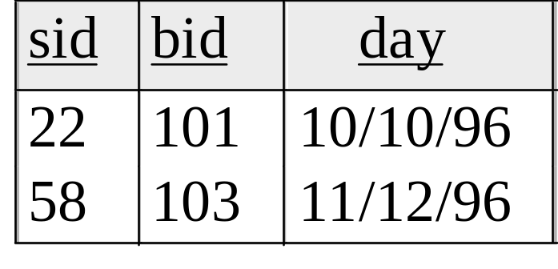
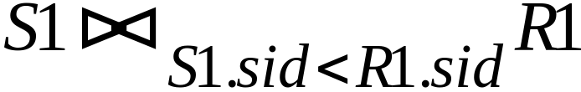
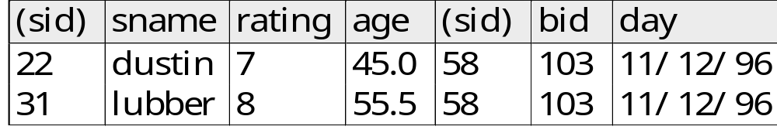
Condition Join (or “theta-join”):
S1
R1
=

Slide 30
Notes about Relational Languages
Each Query input is a table (or set of tables)
Each query output is a table.
All data in the output table appears in one of the input tables
Can we compute:
  SUM
  AVG
  MAX
  MIN
Aggregation function takes a collection of values and returns a single value as a result.

Slide 31
Summary of Relational Algebra Operators
Symbol (Name) Example of Use
σ
(Selection) ^{σ} salary > = 85000 ^{(instructor)}
Return rows of the input relation that satisfy the predicate.
Π
(Projection) ^{Π} ID, salary ^{(instructor)}
Output specified attributes from all rows of the input relation. Remove duplicate tuples from the output.
x
(Cartesian Product) instructor x department
Output pairs of rows from the two input relations that have the same value on all attributes that have the same name.
∪
(Union) ^{Π} name ^{(instructor) ∪ Π} name ^{(student)}
Output the union of tuples from the two input relations.
-
(Set Difference) ^{Π} name ^{(instructor)} ^{-- Π} name ^{(student)}
Output the set difference of tuples from the two input relations.
⋈
(Natural Join) instructor ⋈ department
Output pairs of rows from the two input relations that have the same value on all attributes that have the same name.

Slide 32
End of Chapter 2
Have some additional materials

Slide 33
Relational Algebra on Bags
A bag is like a set but it allows elements to be repeated in a set.
Example: {1, 2, 1, 3, 2, 5, 2} is a bag.
Difference between a bag and a list is that order is not important in a bag.
Example: {1, 2, 1, 3, 2, 5, 2} and
{1,1,2,3,2,2,5} is the same bag

Slide 34
Need for Bags
SQL allows relations with repeated tuples. Thus SQL is not a relational algebra but rather “bag” algebra
In SQL one need to specifically ask to remove duplicates, otherwise replicated tuples will not be eliminated
Operation projection is more efficient on bags than on sets

Slide 35
Operations on Bags
Select applies to each tuple and no duplicates are eliminated
Project also applies to each tuple and duplicates are not eliminated. Example
A B C
Projection on A, B
A B
2 3
1 2 5
2 3 7
1 2
2
3

Slide 36
Other Bag Operations
An element in the union appears the number of times it appears in both bags
Example: {1, 2, 3, 1} UNION {1, 1, 2, 3, 4, 1} =
{1, 1, 1, 1, 1, 2, 2, 3, 3, 4}
An element appears in the intersection of two bags is the minimum of the number of times it appears in either.
Example (con’t): {1, 2, 3, 1} INTERSECTION
{1, 1, 2, 3, 4, 1} = {1, 1, 2, 3}
An element appears in the difference of two bags A and B as it appears in A minus the number of times it appears in B but never less than 0 times

Slide 37


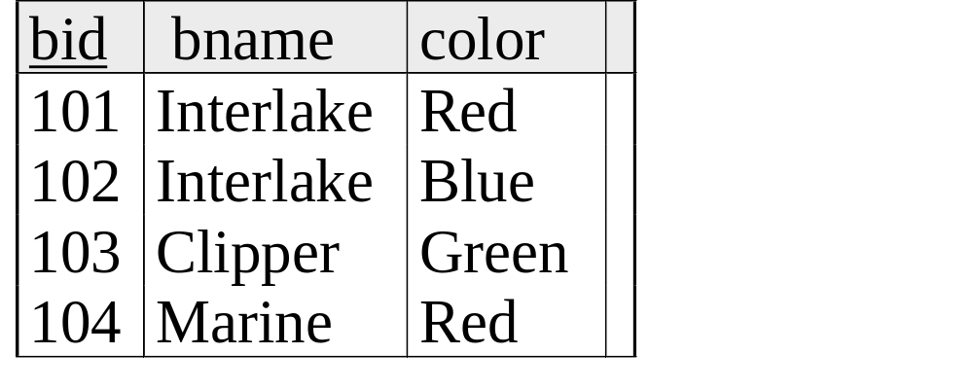
Examples
Reserves
Sailors
_x0016_
Boats

Slide 38
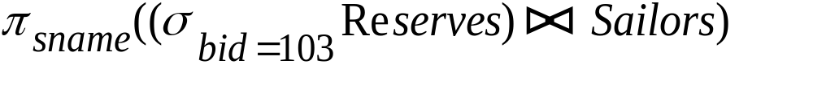
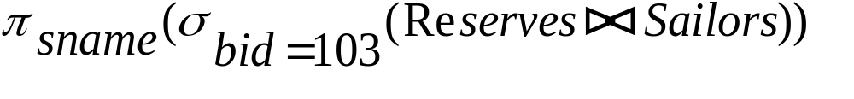
Find names of sailors who’ve reserved boat #103
Solution 1:
Solution 2:

Slide 39
Find names of sailors who’ve reserved a red boat
Information about boat color only available in Boats; so need an extra join:
A more efficient (???) solution:
A query optimizer can find this given the first solution!

